Slide 1

Telecom Churn Analysis
BUAN 6337- Predictive Analysis using SAS – F21
Date: 12/13/2021
Dr. Shervin Tehrani
JSOM, The University of Texas at Dallas
Team: Vikash Kumar
Nguyen Trang Thi Thu
Sameeullah Babar
Sachin Bangaraswamy
Frederick Tatum Henson

Slide 2
Objective
Is to find the factors which are affecting the customers to churn in the telecom industry
Build classifier models to predict customer churn and decide on the best one for the application
Steps followed in the project:
Exploratory Data Analysis, Hypothesis Testing
Data Preparation, Base Model Training, Oversampling
Training Different Models (Binary Logit, Knn, Decision Tree, Random Forest), Test Data Evaluation

Slide 3
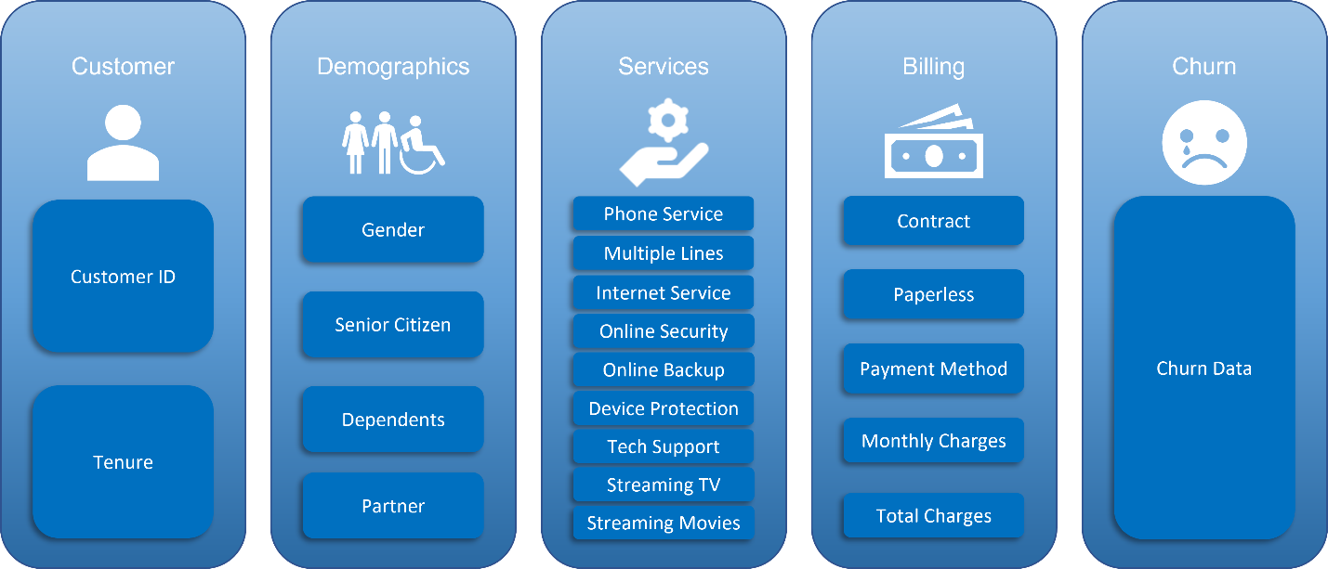
Data overview

Slide 4
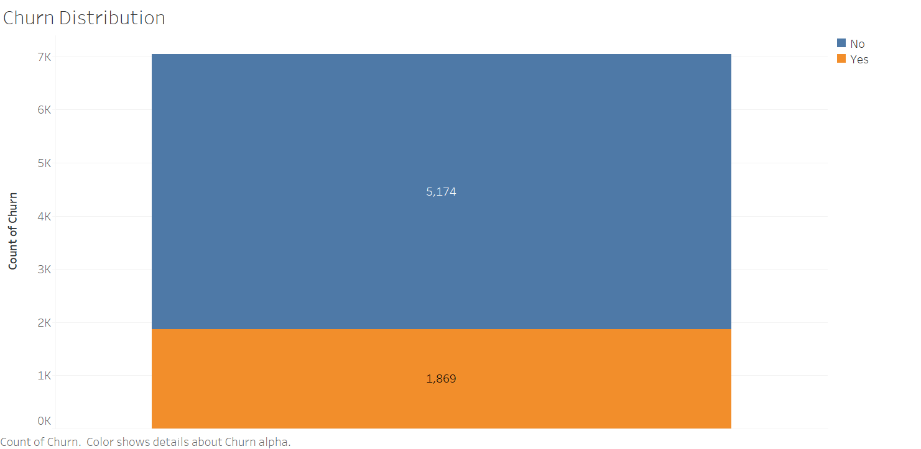
Distribution of target variable
Chart source: Tableau powerpoint export

Slide 5
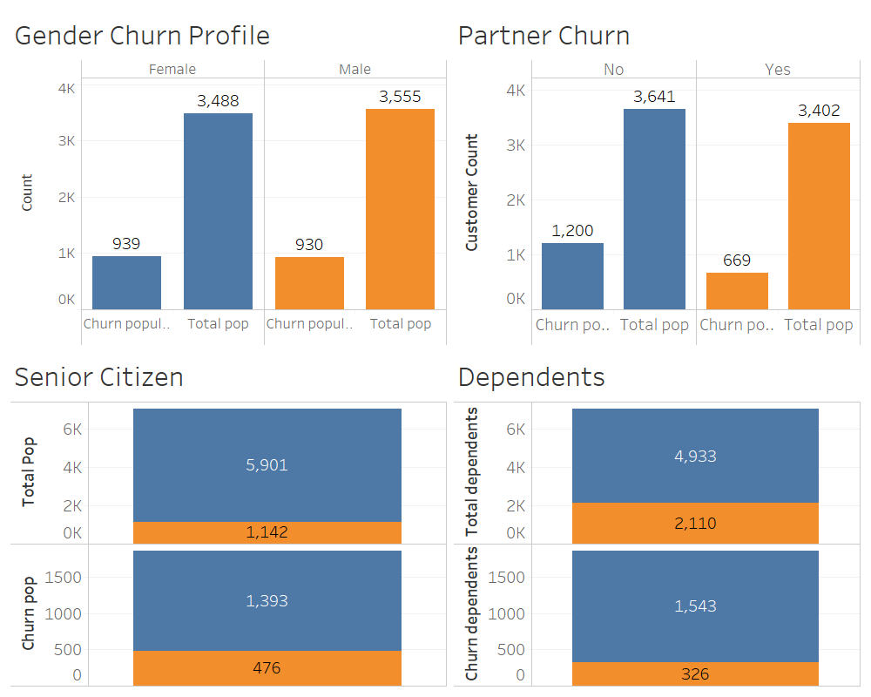
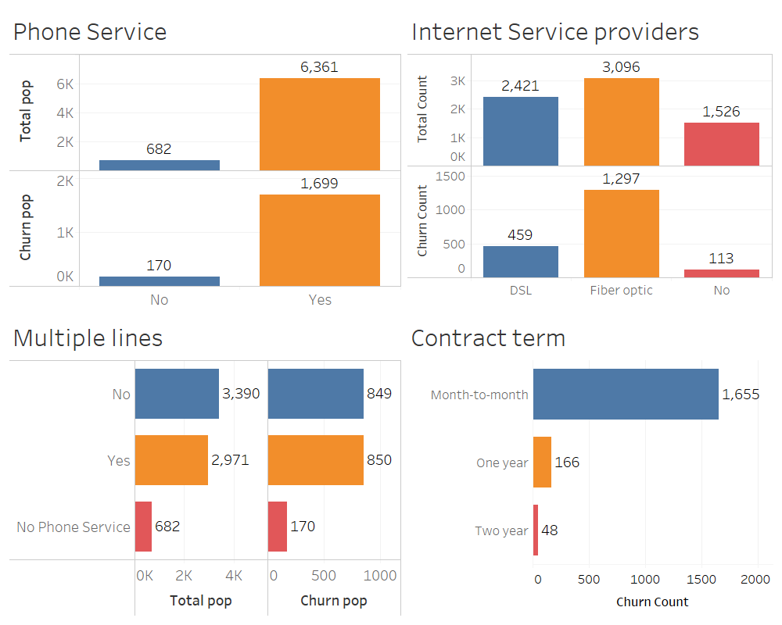
EDA..
Chart source: Tableau powerpoint export

Slide 6
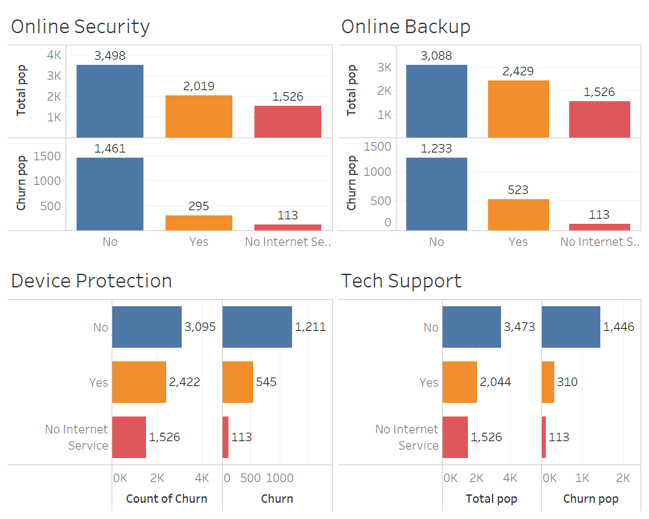
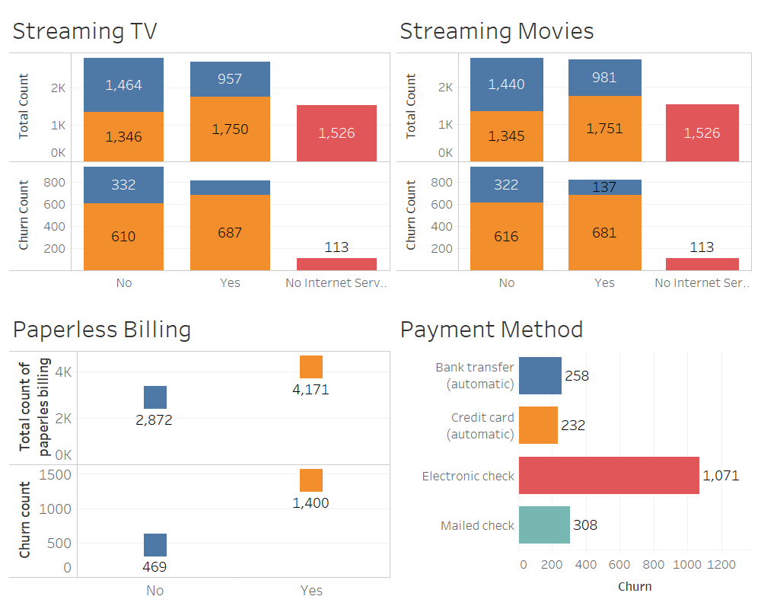
..contd
Chart source: Tableau powerpoint export

Slide 7
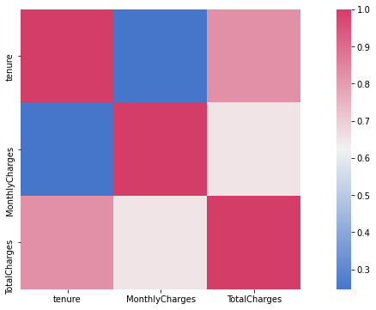
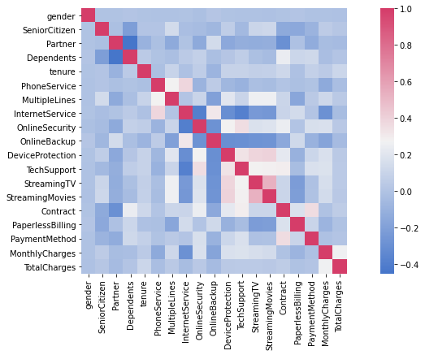
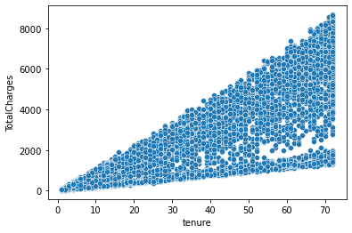
Correlation Between Independent Variables

Slide 8
Hypothesis Testing
Variable | Null Hypothesis | Alternative Hypothesis | Chi-Square | p-value | Reject Null Hypothesis
Gender | Churn is independent from Gender | Churn is dependent on Gender | 0.4755 | 0.4905 | No
Senior Citizen | Churn is independent from Senior Citizen | Churn is dependent on Senior Citizen | 158.4408 | 0.0000 | Yes
Partner | Churn is independent from Partner | Churn is dependent on Partner | 157.5032 | 0.0000 | Yes
Dependents | Churn is independent from Dependents | Churn is dependent on Dependents | 186.3216 | 0.0000 | Yes
Phone Service | Churn is independent from Phone Service | Churn is dependent on Phone Service | 0.8737 | 0.3499 | No
Multiple Lines | Churn is independent from Multiple Lines | Churn is dependent on Multiple Lines | 11.0869 | 0.0009 | Yes
Internet Services | Churn is independent from Internet Services | Churn is dependent on Internet Services | 728.6956 | 0.0000 | Yes
Online Security | Churn is independent from Online Security | Churn is dependent on Online Security | 205.4158 | 0.0000 | Yes
Online Backup | Churn is independent from Online Backup | Churn is dependent on Online Backup | 47.2467 | 0.0000 | Yes
Device Protection | Churn is independent from Device Protection | Churn is dependent on Device Protection | 30.4957 | 0.0000 | Yes
Tech Support | Churn is independent from Tech Support | Churn is dependent on Tech Support | 189.9668 | 0.0000 | Yes
Streaming TV | Churn is independent from Streaming TV | Churn is dependent on Streaming TV | 27.8419 | 0.0000 | Yes
Streaming Movies | Churn is independent from Streaming Movies | Churn is dependent on Streaming Movies | 25.7641 | 0.0000 | Yes
Contract | Churn is independent from Contract | Churn is dependent on Contract | 1179.5458 | 0.0000 | Yes
Paperless Billing | Churn is independent from Paperless Billing | Churn is dependent on Paperless Billing | 256.8749 | 0.0000 | Yes
Payment Method | Churn is independent from Payment Method | Churn is dependent on Payment Method | 645.4299 | 0.0000 | Yes

Slide 9
Algorithms
KNN classifier
Logistic regression
Decision Tree
Random Forest

Slide 10
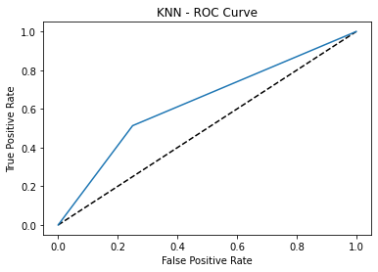
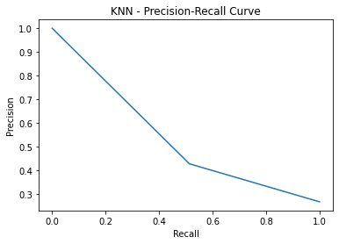
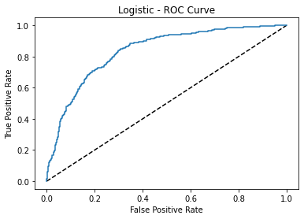
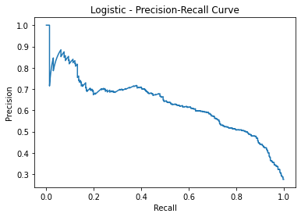
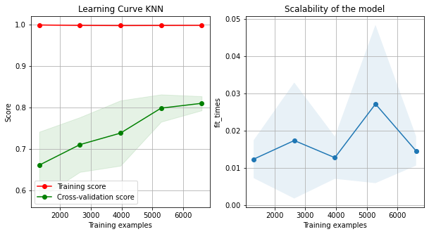
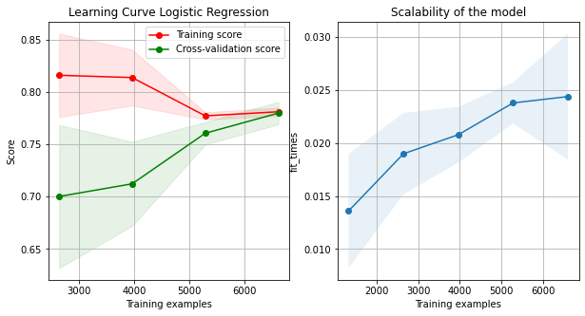
Performance metrics..
KNN Classifier
Logistic Regression

Slide 11
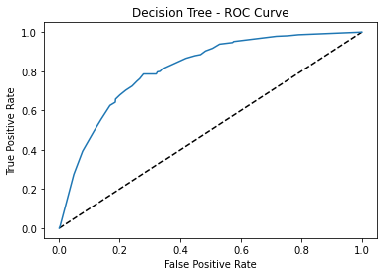
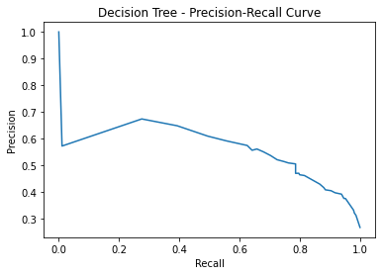
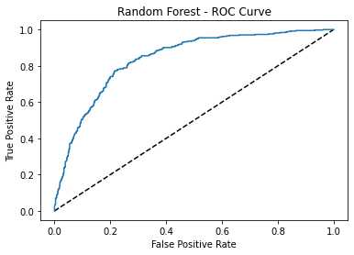
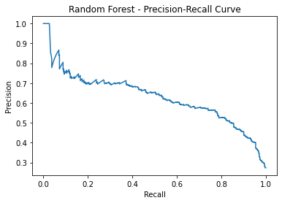
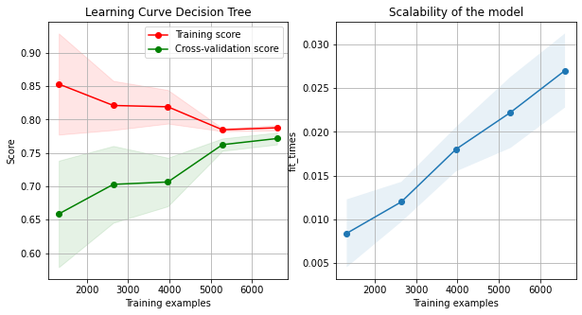
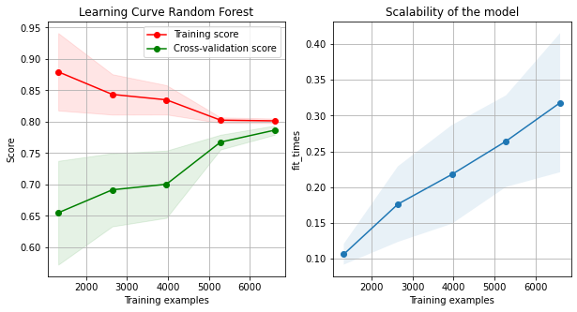
..contd
Decision Tree
Random Forest

Slide 12
Model Comparison
 | KNN | Logistic Regression | Decision Tree | Random Forest
Accuracy (Train) | 0.998184 | 0.781598 | 0.788015 | 0.799153
Accuracy (Test) | 0.687278 | 0.74769 | 0.744136 | 0.769723
Precision (Test) | 0.426667 | 0.517117 | 0.512821 | 0.546642
Recall (Test) | 0.513369 | 0.76738 | 0.748663 | 0.783422
ROC AUC Score (Test) | 0.631805 | 0.835294 | 0.814486 | 0.838055
F1 Score (Test) | 0.466019 | 0.617869 | 0.608696 | 0.643956
AUC Score (Test) | 0.534694 | 0.629228 | 0.564036 | 0.629699

Slide 13
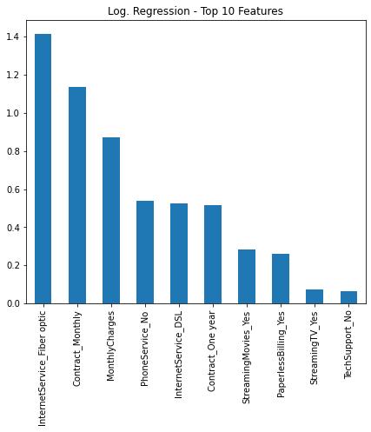
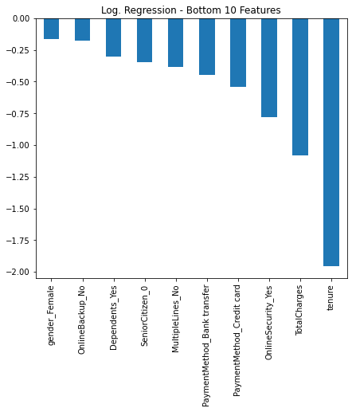
Feature Comparison
As we see InternetService Fiber Optic is the most significant factor, whereas tenure is the least important factor for churn.

Slide 14
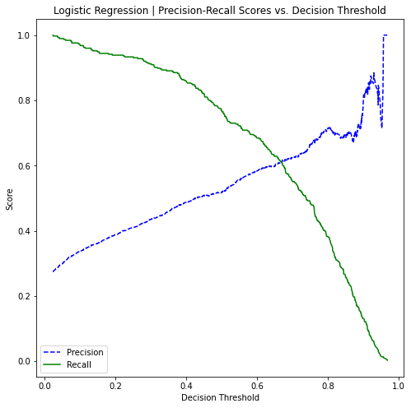
Conclusion
Logistic Regression and Random Forest classifiers have a similar Recall rate of 77% and 78% respectively
Top three important predictors that are contributing positively to customer churn are Internet Service_Fiber Optic, Contract_Monthly and Monthly charges
Our model can be better optimized for prediction if the decision threshold is decreased from 0.50 to 0.38 (Recall 88%) as seen in the below plotted Precision Vs Recall curve

Slide 15
Our Recommendations.
Since most of the internet using customers are unhappy with the Fiber Optic plans, conducting a survey or collecting feedback from them to understand the pain points would help in overcoming the churn rate. Offer Fiber Optic premium service with 1-year and 2-year Contracts
Companies need to offer discounts (Family Package) on customers who has a partner or a dependent as they tend to pay more for the services monthly which is one of the factors of churn
Clearly, the churn rate is more with customers who are contracted on monthly basis. This can be reduced by offering more lucrative offers for a longer-term contract
High-cost incentives: customized packages with the support of Sales Rep team, upgrading premium services without charge when customers extend contracts, free sign-on bonus
Therefore, we advise the company to tailor their retention programs based on customers’ probability to churn and their assumed feature importance as specified by our model.

Slide 16
References
https://www.smartlook.com/blog/customer-Churn-retention/
https://www.outboundengine.com/blog/customer-retention-marketing-vs-customer-acquisition-marketing/
https://www.getfeedback.com/resources/cx/40-stats-Churn-customer-satisfaction/

Slide 17

Thank you

